Slide 1
Embedded SQL
Structured Query Language (SQL) is a standardized language used to manipulate database objects and the data they contain.
It comprises of several different statements that are used to manipulate data structures and data values.
However, SQL being nonprocedural does not serve the purpose of a general-purpose programming language.
As a result, database applications are usually developed by combining capabilities of a high-level programming language with SQL
The simplest approach is to embed SQL statements directly into the source code that will be used to create an application. This technique is referred to as embedded SQL programming.

Slide 2
Embedded SQL
SQL command can be called from the host language program (example Java, Pro C, Cobol, C#, etc).
High-level programming language compilers cannot interpret SQL statements. Hence source code files containing embedded SQL statements must be preprocessed before compiling.
Thus, each SQL statement coded in a high-level programming language source code file must be prefixed with the keywords EXEC SQL and be terminated with either a semicolon or the keyword END-EXEC.
Likewise, the database manager cannot work directly with high-level programming language variables. Instead, it must use special variables known as host variables to move data between an application and a database
Host variables are ordinary programming language variables. To be set apart, they must be defined within a special section known as declare section.
EXEC SQL BEGIN DECLARE SECTION;
char empid[7];
double sal;
EXEC SQL END DECLARE SECTION;

Slide 3
Embedded SQL
Connecting to Database using embedded sql
EXEC SQL CONNECT :userid IDENTIFIED BY :password;
EXEC SQL CREATE TABLE Test(a int);
EXEC SQL INSERT INTO Test VALUES(1);
EXEC SQL SELECT MAX(a) INTO :value from R;
printf(“Max value=%d\n”,value);
The complete syntax for CONNECT statement is :
EXEC SQL CONNECT { :user IDENTIFIED BY :usr_psw }
[[ AT { dbname | :host_variable }] USING :connect_string ]
[{ALTER AUTHORIZATION :newpswd | IN { SYSDBA | SYSOPER } MODE} ] ;
The following statement may also be used:
EXEC SQL connect to server user user-name using password;

Slide 4
Embedded SQL
The Main Language constructs are:
Connecting to a database: EXEC SQL CONNECT
Declaring variables: EXEC SQL BEGIN /END DECLARE SECTION
Statements: EXEC SQL Statement

Slide 5
Embedded SQL
Example : 1
int main()
{
EXEC SQL BEGIN DECLARE SECTION;
int OrderID, CustID;
char SalesPerson[10], Status[6];
EXEC SQL END DECLARE SECTION;
printf(“Enter order number:”);
scanf(“%d”,&OrderID);
EXEC SQL SELECT CustID, SalesPerson, Status FROM Orders WHERE OrderID = :OrderID INTO :CustID, :SalesPerson, :Status;
printf(“Customer number : %d” \n”,CustID);
printf(“Salesperson:%s\n”,SalesPerson);
printf(“Status: %s\n”,Status);
return 0;
}

Slide 6
Embedded SQL
Example : 2
int main()
{
EXEC SQL BEGIN DECLARE SECTION;
char c_sname[10];
int c_sid, rating;
float c_age;
EXEC SQL END DECLARE SECTION;
printf(“Enter sailors details:”);
scanf(“%s%d%d%f”,cname,&c_sid,&c_rating,&c_age);
EXEC SQL INSERT INTO sailors VALUES(:c_sid,:C_sname,:c_rating,:C_age);
return 0;
}

Slide 7
Handling SQL Exception
The SQLSTATE variable should be checked for errors and exceptions after each embedded SQL statement. SQL provides the WHENEVER command to simplify the task.
EXEC SQL WHENEVER [SQLERROR|NOT FOUND] [CONTINUE|GOTO STMT];
IF SQLERROR is specified and the value of SQLSTATE indicates an exception, the control is transferred to STMT, which is presumably responsible for exception handling. The NOT FOUND condition is set to true if the value of SQLSTATE is 02000, which denotes NO DATA
The C data type for SQLSTATE is char[6]
You can find the listing of SQLSTATE values here :
https://www.ibm.com/support/knowledgecenter/en/ssw_ibm_i_61/rzala/rzalaccl.htm
EXEC SQL INCLUDE SQLCA;
is required to identify the place where the preprocessor should insert the special variables used for communication between the program and the database.
Incorporates SQL's error handling mechanism (SQL Communications Area).

Slide 8
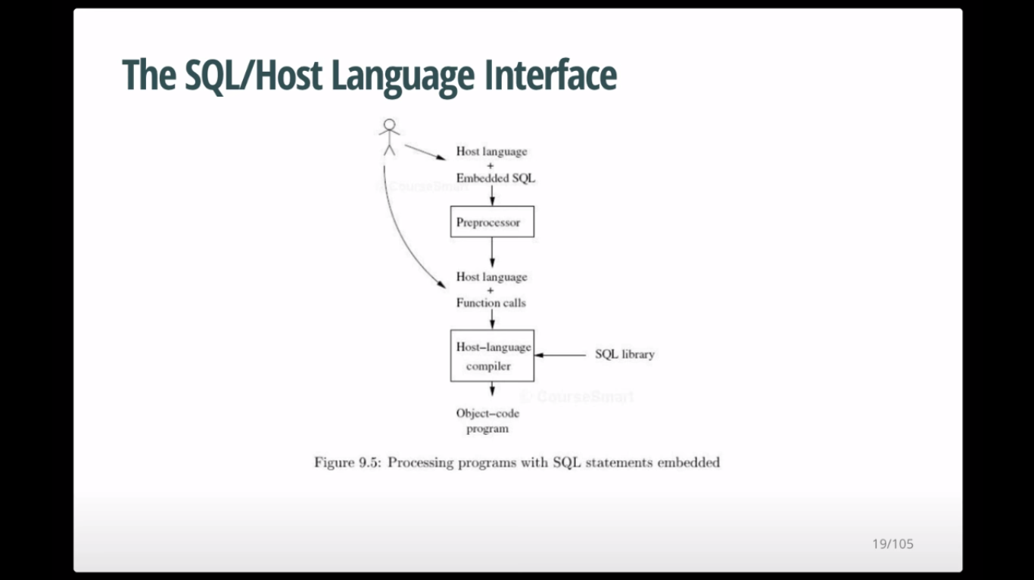

Slide 9
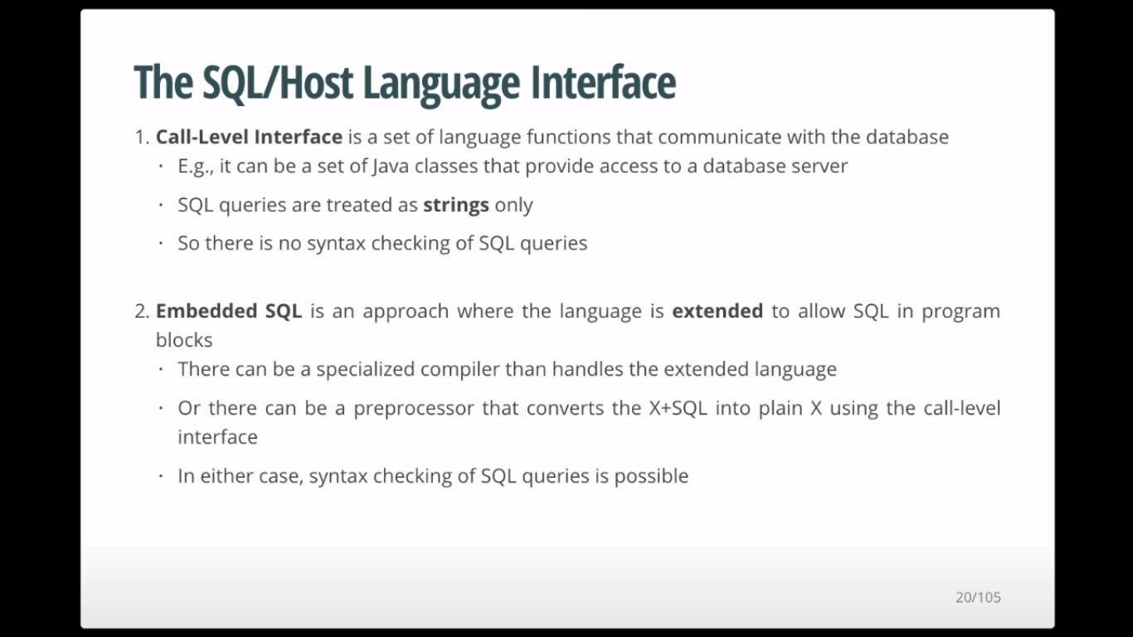

Slide 10
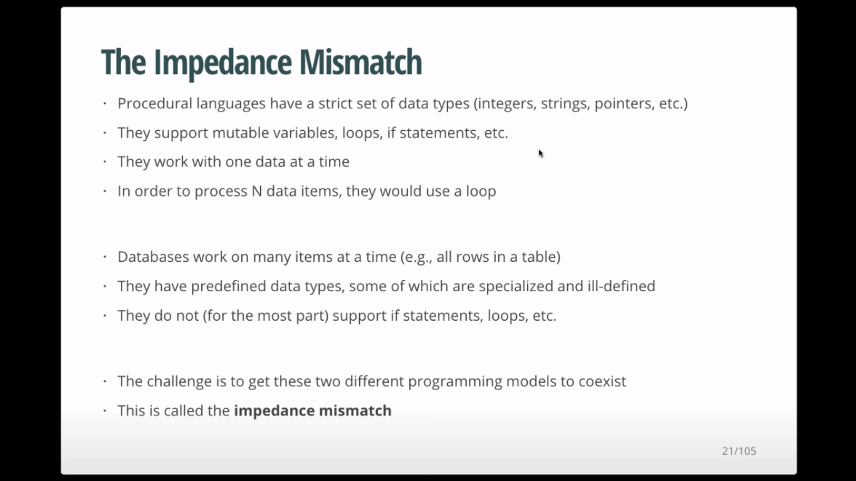

Slide 11
Dynamic SQL
Dynamic SQL means composing and executing new (not previously compiled) SQL statements at run-time.
Although static SQL statements are relatively easy to incorporate, Dynamic SQL statements are much more flexible as they can be constructed at run time.
Dynamic queries can be complex because the type and number of retrieved attributes are unknown at compile time.
INSERT INTO EMPLOYEES VALUES (?, ?)
DELETE FROM DEPARTMENT WHERE DEPTID = ?
The two main commands required for dynamic SQL are PREPARE and EXECUTE

Slide 12
Dynamic SQL
Example :
int main()
{
EXEC SQL BEGIN DECLARE SECTION;
char csqlString[256];
EXEC SQL END DECLARE SECTION;
printf(“Enter the delete command:”);
gets(csqlString);
EXEC SQL PREPARE sqlcommand FROM :csqlstring;
EXEC SQL EXECUTE sqlcommand;
return 0;
}
The above is an example of a C program segment that uses dynamic SQL for deleting from a table. The value passed into the csqlString could be :
"DELETE FROM sailors WHERE rating>5"

Slide 13
Dynamic SQL
A command can be prepared once and executed multiple number of times. In this case the PREPARE and EXECUTE commands are separated.
But, if the SQLcommand is to be executed only once ,
the PREPARE and EXECUTE commands can be combined and executed as:
EXEC SQL EXECUTE IMMEDIATE :csqlString;

Slide 14
Dynamic SQL
The dynamic SQL program may contain a ‘?’ which is a placeholder for a value that is provided when the program is executed.
Example :
int main()
{
EXEC SQL BEGIN DECLARE SECTION;
char *sqlcmd = “UPDATE account SET balance=balance*1.5 WHERE acc_no=?”;
Char account[10];
EXEC SQL END DECLARE SECTION;
EXEC SQL PREPARE dynprog FROM :sqlcmd;
printf(“Enter the account number:”);
gets(account);
EXEC SQL EXECUTE dynprog using :account;
return 0;
}

